Slide 1


Ai Core Hangman Project
12 May 2022

Slide 2
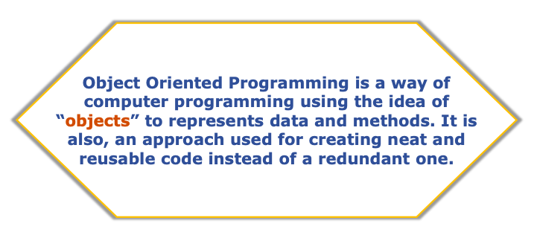

Slide 3
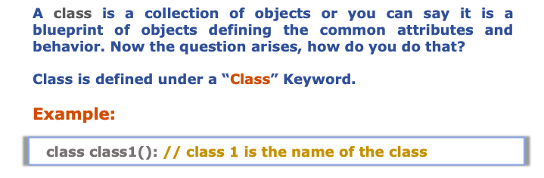

Slide 4
Defining a Class
A class is a special data type which defines how to build a certain kind of object.
The class also stores some data items that are shared by all the instances of this class
Instances are objects that are created which follow the definition given inside of the class

Slide 5
Methods in Classes
Define a method in a class by including function definitions within the scope of the class block
There must be a special first argument self in all of method definitions which gets bound to the calling instance
There is usually a special method called __init__ in most classes

Slide 6

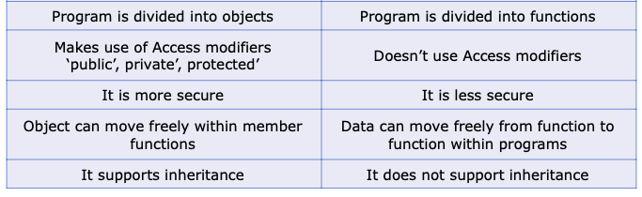

Slide 7
What do I need to know to complete the Hangman Project?
Git
GitHub
Python Programming
Data types
Lists
Loops
Functions

Slide 8


Slide 9


